Slide 1
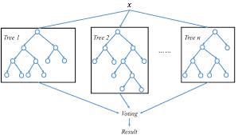
Random Forests
Random Forests work by creating multiple decision trees, each based on a random subset of your data and using a random subset of features. It keeps track of how often different variables are used to make decisions. By averaging the importance of each variable across all the trees, Random Forests can highlight which variables consistently have the most impact.

Slide 2
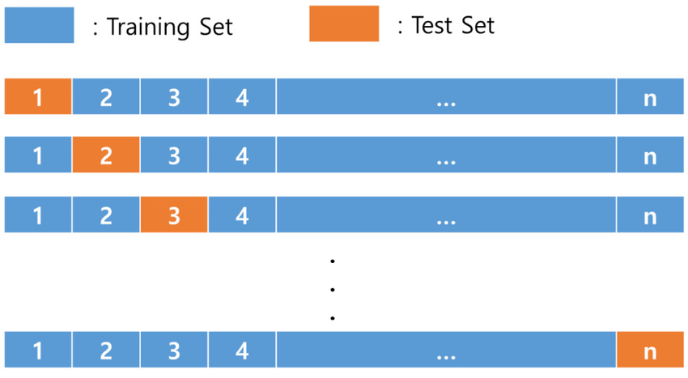
Leave-One-Out Cross-Validation (LOOCV)
LOOCV uses almost all your data to train the model, except for one single data point, which it uses to test the model. This process is repeated for each data point in your dataset, which is important when you don't have a lot of data to work with.

Slide 3
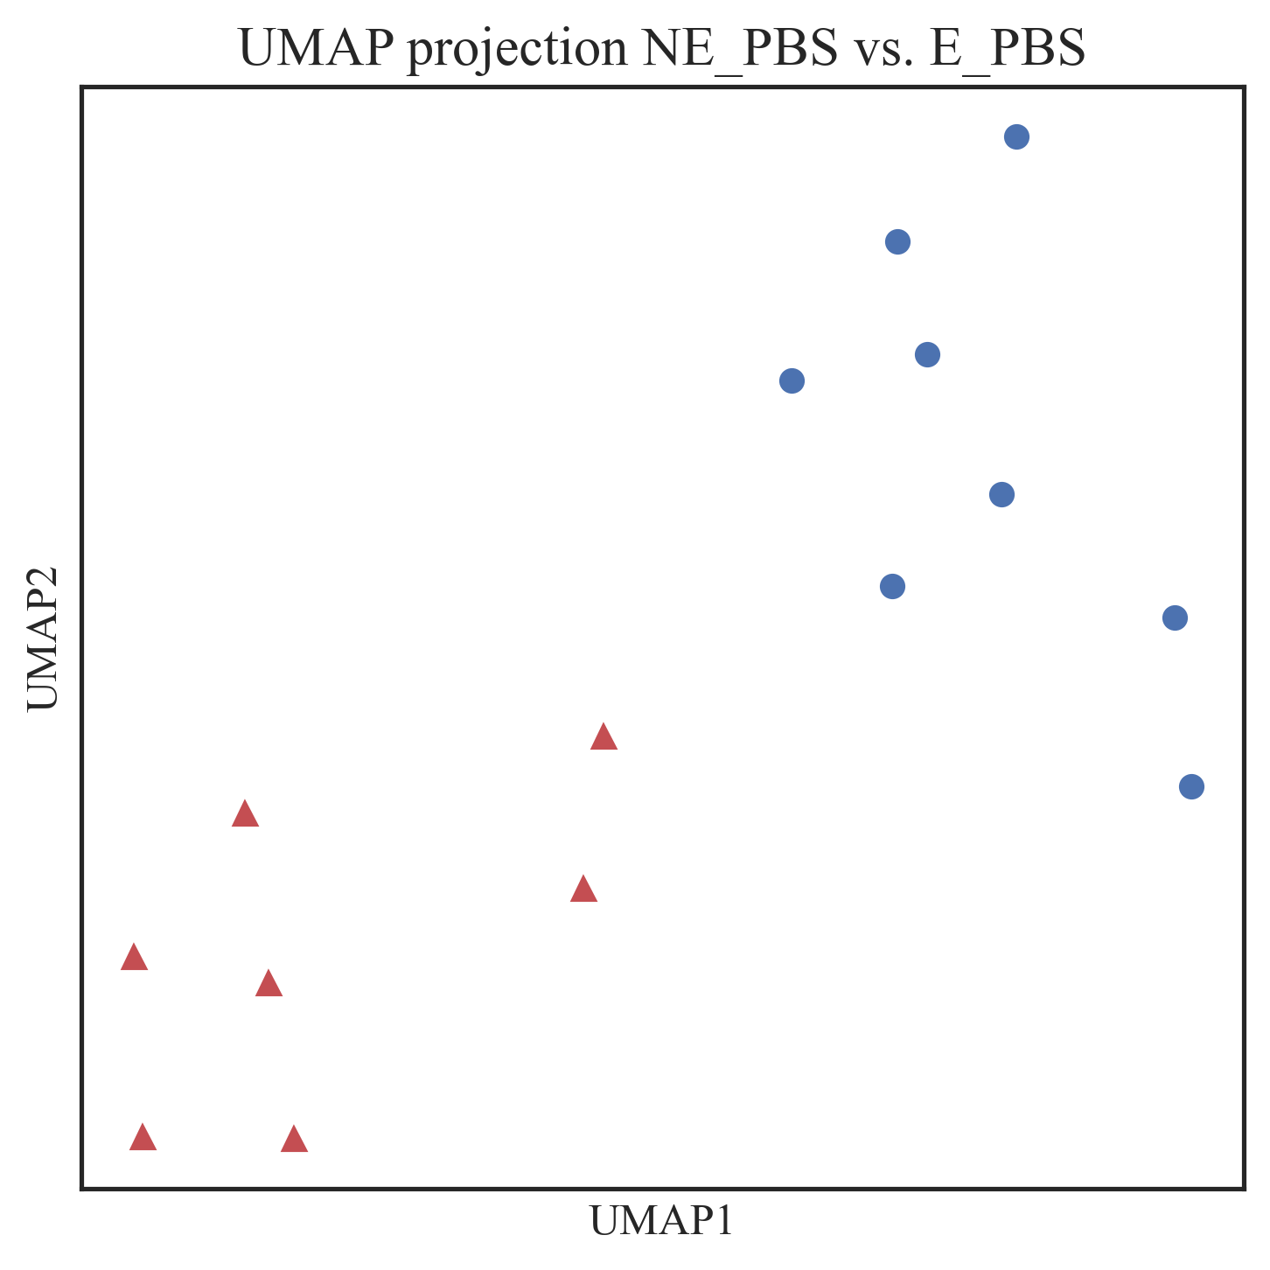
Feature selection
Top 10 features
NE_PBS vs. E_PBS
{'ENSMUSG00000108957': 'Gm45235',
'ENSMUSG00000026579': 'F5',
'ENSMUSG00000067201': 'H2-M9',
'ENSMUSG00000109539': 'Gm44667',
'ENSMUSG00000052724': 'Gm9888',
'ENSMUSG00000048304': 'Slitrk3',
'ENSMUSG00000104585': '4921511C10Rik',
'ENSMUSG00000034579': 'Pla2g3',
'ENSMUSG00000079711': 'Smok4a',
'ENSMUSG00000021384': 'Susd3'}

Slide 4
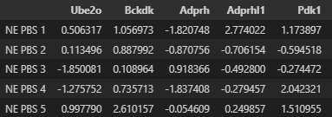
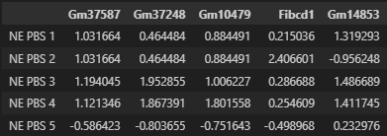
Integrating multiple omics datasets
Multiomics dataset
Proteomics (tissue)
Transcriptomics (tissue)

Slide 5
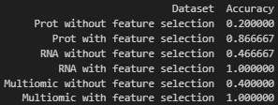
Results (NE_PBS vs. E_PBS)
Prot stands for proteomics data gathered from the tissue
RNA stands for the transcriptomics data gathered also from the tissue
Multiomic stands for the union of both datasets
No improvement over transcriptomic

Slide 6
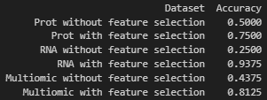
Results (NE_PBS vs. NE_AmAc)
93.75% cross-validation score for transcriptomic data after feature selection
Decrease in cross-validation score in relation to transcriptomic

